Slide 1
PROJECT ASSIGNMENT 1
PART 1

Slide 2
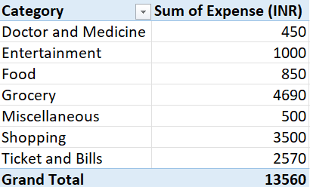
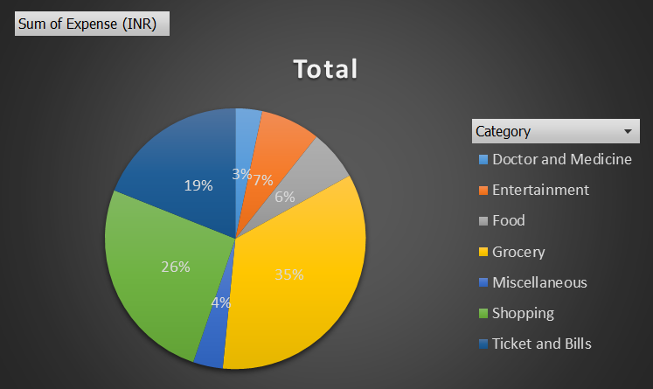
•How much is spent for each category (Pivot Table)
•Visually represent the amount spent against each category is what percentage of the total expense amount (Pivot Chart)
TASK 1

Slide 3
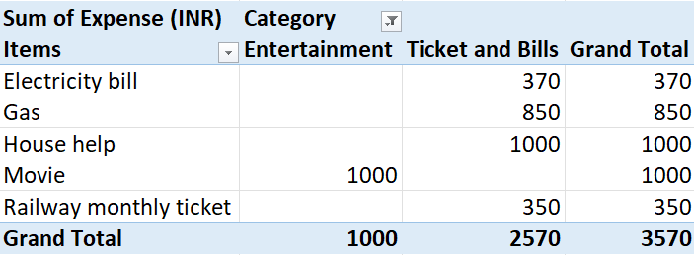
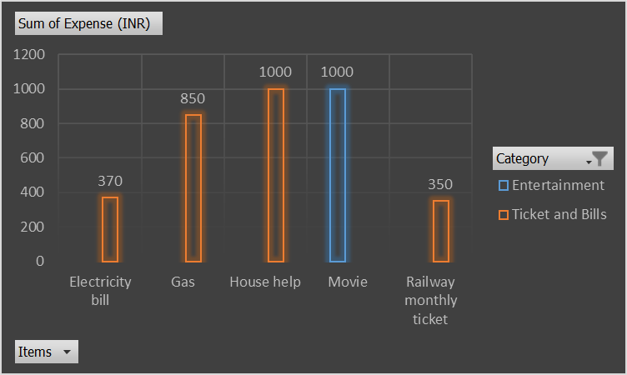
•How much is spent on different items of each category (Pivot Table)
•Visually represent the amount spent on different items of Entertainment and Tickets and bills category (Pivot Chart)
TASK 2

Slide 4
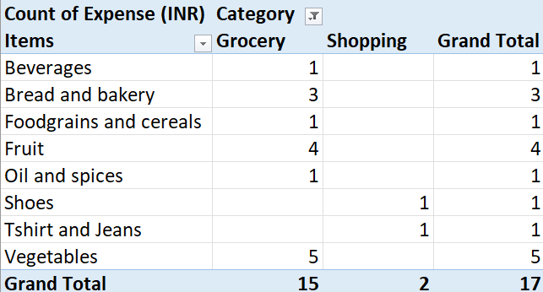
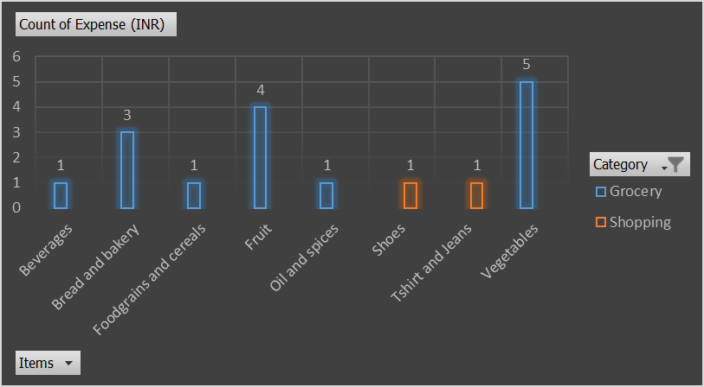
•How many times money has been spent against different items of each category (Pivot Table)
•Filter the data to display the data for Grocery items and Shopping items
TASK 3

Slide 5
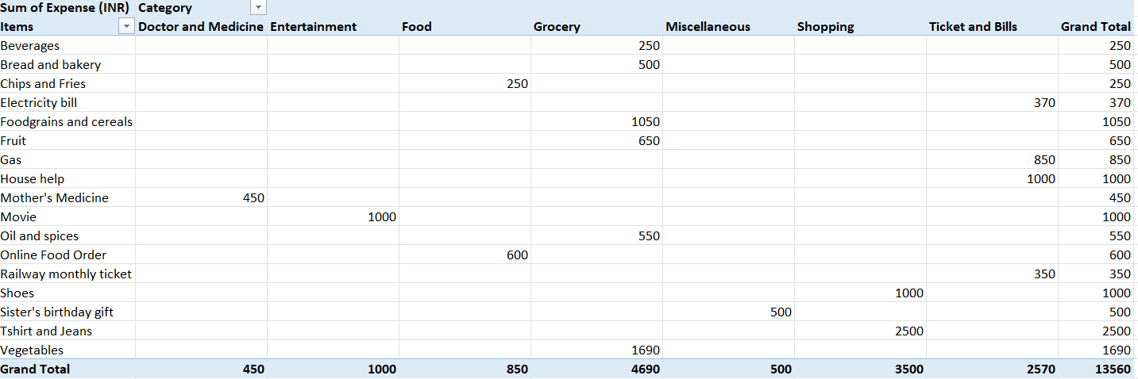
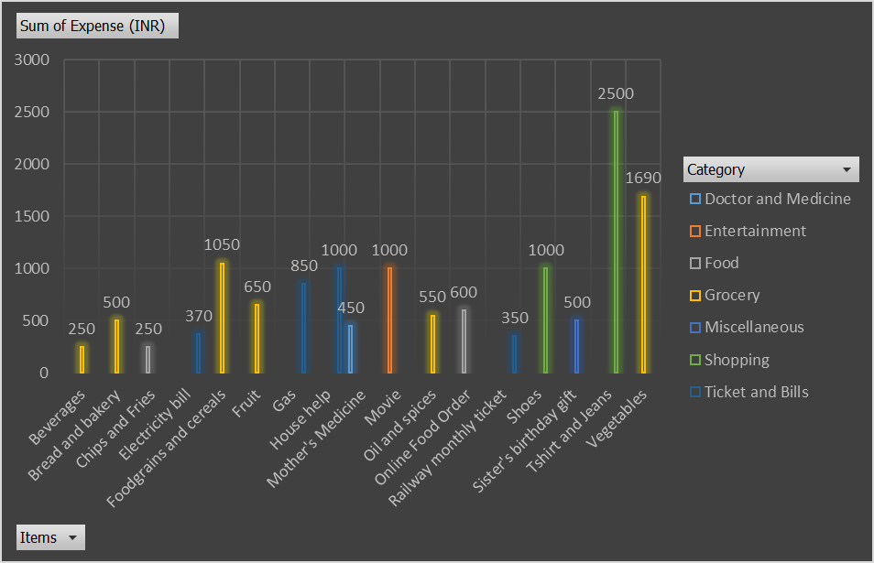
•What amount is spent on each item of the categories with highest and 2nd highest expense amount (Pivot Table)
•Visually represent the data with data bars (Conditional formatting)
TASK 4

Slide 6
PROJECT ASSIGNMENT 1
PART 2

Slide 7
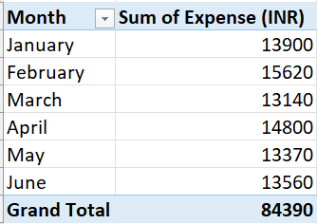
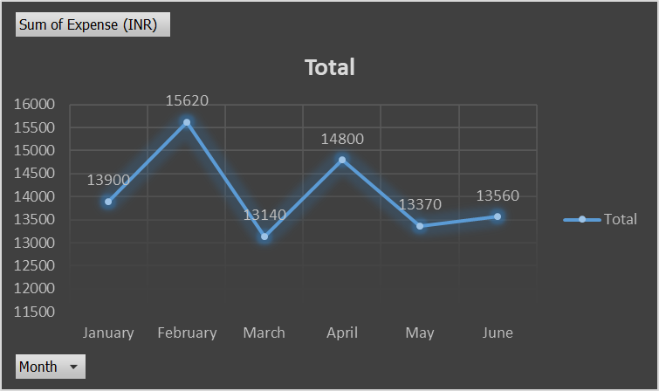
•Month-wise trend of expenses (Pivot table and chart)
•Find out the month Nitin spent the most
TASK 1

Slide 8
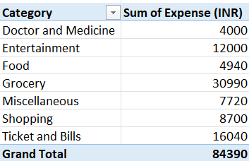
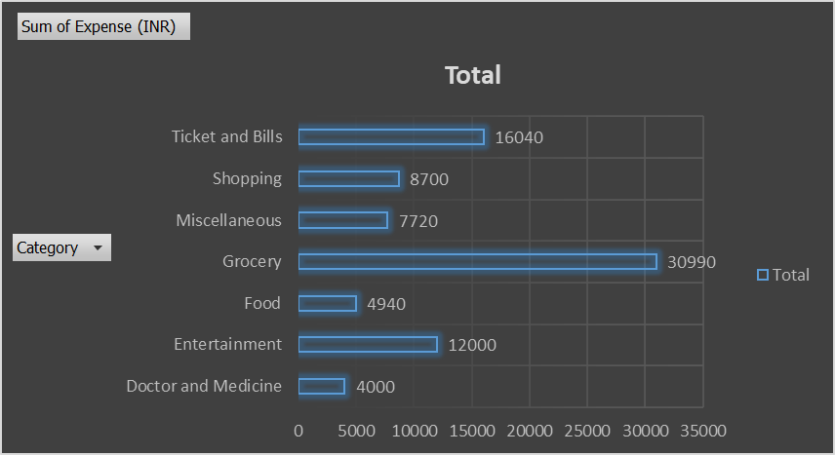
•Month-wise trend of expenses (Pivot table and chart)
•Find out the month Nitin spent the most
TASK 2

Slide 9
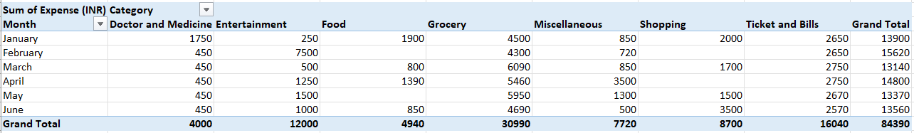
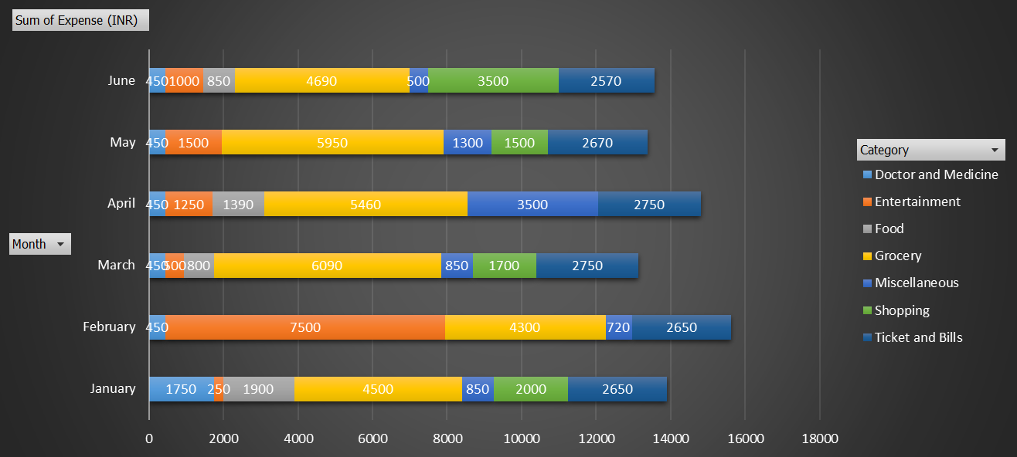
•Month-wise expense of each category (Pivot table)
•Find out 2 categories with higher expenses for each of the 6 months
TASK 3

Slide 10
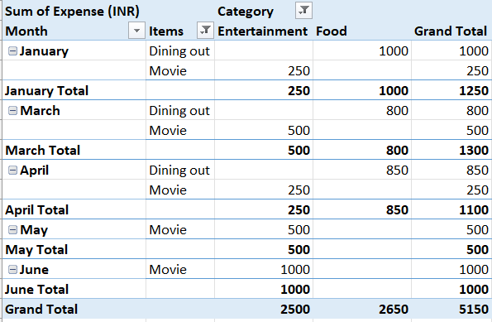
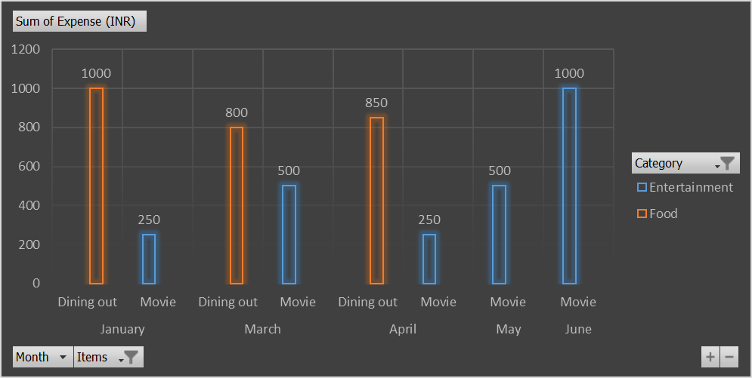
•How much is spent in each month against different items of Entertainment, Food and Shopping categories (Pivot table)
•Find out which months have the highest amount spent for movies and dining out
TASK 4

Slide 11
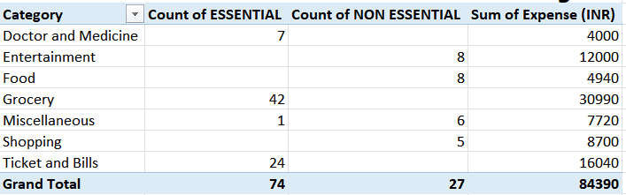
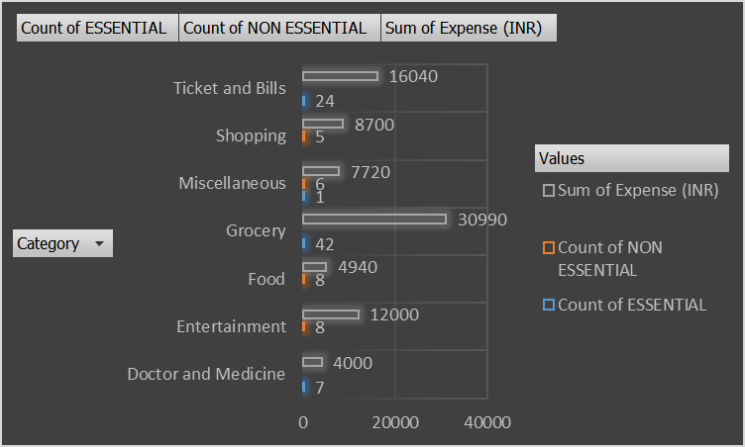
•Decide on the essential and less essential items and analyse the expenses
•Recommend how can Nitin increase his savings
TASK 5

Slide 12
Recommend how can Nitin increase his savings
Track and Analyze Expenses
Maintain a detailed budget by regularly tracking all expenses.
Review expenses to identify and eliminate unnecessary expenditures.
Reduce Less Essential Expenses
Reduce dining out and online food orders frequency.
Opt for streaming movies at home instead of going to the cinema.
Limit non-essential shopping and buy only during sales or discounts.
Set and adhere to a strict budget for miscellaneous expenses.
Optimize Essential Expenses
Purchase non-perishable grocery items in bulk for discounts.
Buy seasonal fruits and vegetables for lower prices.
Use coupons and look for grocery discounts.
Implement energy-saving measures to reduce utility bills.
Cancel unnecessary subscriptions or services.
Use cheaper commuting options like public transportation or carpooling.

Slide 13
Set Savings Goals
Build an emergency fund equivalent to 3-6 months of living expenses.
Set up automatic transfers to a savings account each month.
Invest in low-risk options like fixed deposits, mutual funds, or retirement accounts.
Increase Income
Earn extra income through freelance work, part-time jobs, or selling unused items.
Invest in skill development for higher-paying job opportunities or promotions.
Financial Planning
Consult a financial advisor for a personalized financial plan and investment strategy.
Focus on paying off debts to reduce interest payments and improve savings.

Slide 14
THANK YOU !!!

